Slide 1
DES Algorithm Implementation
GROUP-10
Yasa Vivek Reddy-21WU0101009
GV Karthikeya Reddy-21WU0101054
Rohit Reddy -21WU0101058
Chandu Sagar- 21WU0101006

Slide 2
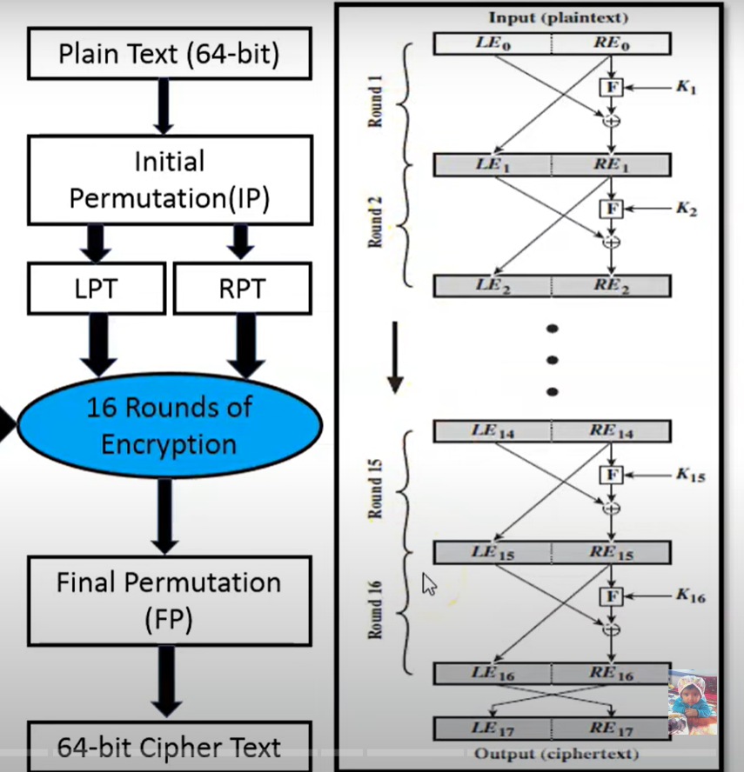
objectives
1. Algorithm Mastery: Understand the core principles of DES encryption, including key generation and Feistel network structure.
2. Code Proficiency: Develop a functional Python implementation of the DES algorithm, showcasing programming skills.

Slide 3
OUTCOMES
1. DES Understanding: In-depth knowledge of DES algorithm's design and operation.
2. Implemented DES: Functional Python code demonstrating DES encryption and decryption.

Slide 4
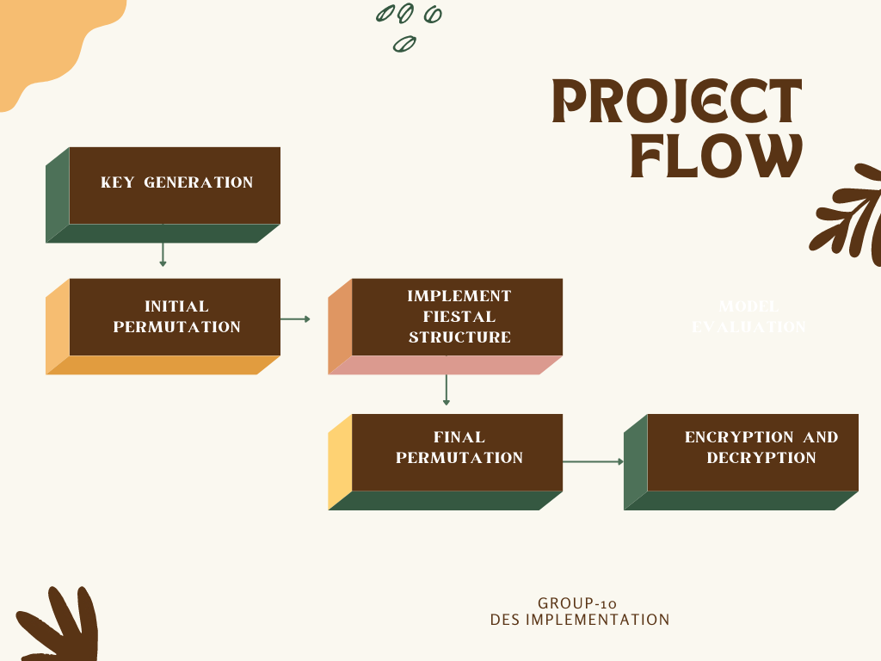

Slide 5
